Slide 1
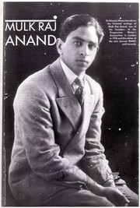
Introduction — About the Author
MULK RAJ ANAND
1905 – 2004
Pioneer of Indian writing in English
Gave voice to the poor, workers & marginalised
Explored emotions, dignity & inner lives
Stories are simple on the surface — but carry deep meaning about human existence
Mulk Raj Anand · The Weight of the Ordinary · English PBL

Slide 2
Why We Chose Him
We chose Mulk Raj Anand because his writing focuses on ordinary life — not extraordinary events.
He doesn't talk about wars or revolutions. Instead, he shows how small, everyday moments can completely change a person's life.
Loss
Pain
Change
doesn't always happen dramatically
is often silent
The biggest changes are often the quietest ones
This idea became the foundation of our project.
Mulk Raj Anand · The Weight of the Ordinary · English PBL

Slide 3
Theme Introduction
Theme Introduction
"The Weight of the Ordinary"
The central theme of our project
What it means
What we noticed
Simple, everyday experiences can carry deep emotional impact — weight that is invisible on the surface.
Across all three stories, a common quiet emotional journey — every character goes through the same arc.
Mulk Raj Anand · The Weight of the Ordinary · English PBL

Slide 4

Theme Breakdown & SDG 10
Core Structure + Reduced Inequalities
WHOLENESS
The character has something meaningful — innocence, dignity, or identity.
LOSS
Something important is taken away — not always violently, sometimes through simple situations.
DIMINISHMENT
The character is left incomplete — not broken loudly, but silently reduced.
SDG 10 — Reduced Inequalities
Wholeness → what every person deserves regardless of class or occupation (dignity, purpose, recognition)
Loss → structural failure: a child unprotected, a worker dismissed, a craftsman replaced without thought
Diminishment → quiet acceptance that some people simply matter less — what real inequality looks like
Mulk Raj Anand · The Weight of the Ordinary · English PBL

Slide 5
Story 1 — The Lost Child
Innocence
THE LOST CHILD
Emotional Arc
WHOLENESS
Joy and security — feels whole with parents
At the beginning:
The child is happy and excited
He wants toys, sweets, and flowers
LOSS
Separation in the crowd — belonging suddenly gone
After separation:
DIMINISHMENT
Emptiness — every desire becomes meaningless
Nothing matters anymore
All his desires disappear instantly
Key Insight
The moment the child loses his parents, the entire world loses its colour. Loss of belonging transforms everything around us.
Belonging is more important than material happiness.
Mulk Raj Anand · The Weight of the Ordinary · English PBL

Slide 6
Story 2 — The Gold Watch
Dignity
THE GOLD WATCH
Emotional Arc
WHOLENESS
Purpose and dedication — life defined by work
The story:
A worker retires after years of loyal service and receives a gold watch as a reward.
LOSS
Retirement removes relevance — years end with a token
In reality:
DIMINISHMENT
Unvalued — a lifetime reduced to a small object
The gift feels small compared to his lifelong effort
It highlights how easily people are forgotten
Key Insight
Honour can be an insult in disguise. A gold watch cannot measure a human life — and that gap is where the story lives.
Dignity can be quietly taken away.
Mulk Raj Anand · The Weight of the Ordinary · English PBL

Slide 7
Story 3 — The Cobbler and the Machine
Identity
THE COBBLER &
THE MACHINE
Emotional Arc
WHOLENESS
Identity through craft — skill was his entire self
The story:
A cobbler's traditional skill becomes useless with the arrival of machines.
LOSS
Livelihood replaced by machines overnight
Important points:
DIMINISHMENT
Erased — not by cruelty, but by indifference
No one intentionally harms him
Progress simply makes him irrelevant
Key Insight
When a person's skill is their identity, making that skill obsolete erases who they are — not through hatred, but through forgetting.
Change can silently erase a person's value.
Mulk Raj Anand · The Weight of the Ordinary · English PBL

Slide 8
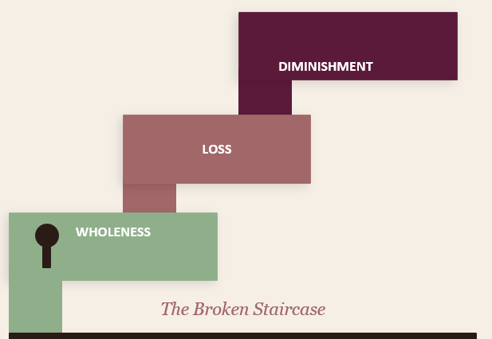
3D Model & Conclusion
The Broken Staircase
Symbolism
The staircase
Life's upward arc — desire for progress
Broken top step
Dreams that remain incomplete
Floating fragment
Lost identity, dignity, or belonging
Figure at base
The character — stopped, not defeated
Analysis cards
Labels on each step: story, moment, theme
Thank You · Mulk Raj Anand · The Weight of the Ordinary · English PBL

